Slide 1
Module 3: Prepare your Environment Activate SharePoint Online Migration
ETHAN IRONS

Slide 2
Conditions and Terms of Use

Slide 3
How to view this presentation?
To switch to the Notes Page view:
On the ribbon, select the View tab, and then select Notes Page
To navigate through notes, use the Page Up and Page Down keys
Zoom in or zoom out, if required
In the Notes Page view, you can:
Read any supporting text—now, or after the delivery
Add notes to your copy of the presentation, if required
Take the presentation files home with you

Slide 4
Objective

Slide 5
Sections
In this lesson, you will learn:
User Creation
Tenant Settings
Site Creation
Hybrid
Notes:
Section 1 – User Creation: How to prepare your user accounts for migration
Section 2 – Site Creation: Creating destination sites
Section 3 – Tenant Settings and Tools: Reviewing your Microsoft 365 admin controls and options
Section 4 – Hybrid: Hybrid SharePoint options

Slide 6
User Creation
Notes:
User Creation and Management:
Cloud Only vs Hybrid Identity - AD Connect

Slide 7
User Creation Overview
Before migrating your content, users must be pre-provisioned in Microsoft 365.
Pre-provisioning users is a prerequisite for permission migration.
Two types of user creation options
Cloud Only
Hybrid Identity - AD Connect (most common)
Notes:
Prepare for directory synchronization to Microsoft 365 – (https://docs.microsoft.com/en-us/office365/enterprise/prepare-for-directory-synchronization?redirectSourcePath=%252farticle%252fprepare-to-provision-users-through-directory-synchronization-to-office-365-01920974-9e6f-4331-a370-13aea4e82b3e)

Slide 8
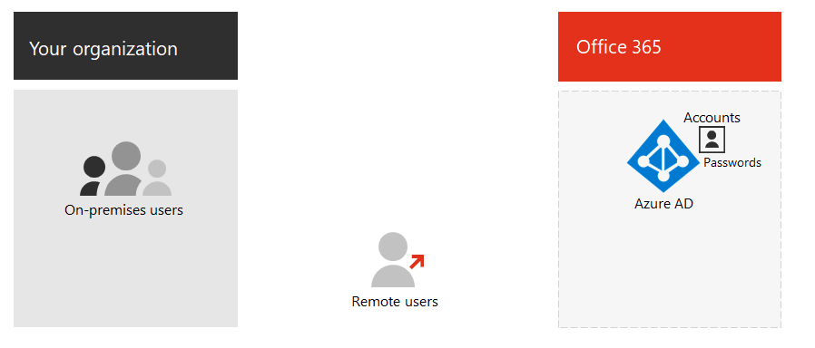
Cloud Only
A cloud-only identity account that only exists in Azure AD.
Both on-premises and remote (online) users use their Azure AD user accounts and passwords to access Microsoft 365 cloud services.
Notes:
A cloud-only identity uses user accounts that exist only in Azure AD. Cloud identity is typically used by small organizations that do not have on-premises servers or do not use AD DS to manage local identities.
Both on-premises and remote (online) users use their Azure AD user accounts and passwords to access Microsoft 365 cloud services. Azure AD authenticates user credentials based on its stored user accounts and passwords.

Slide 9
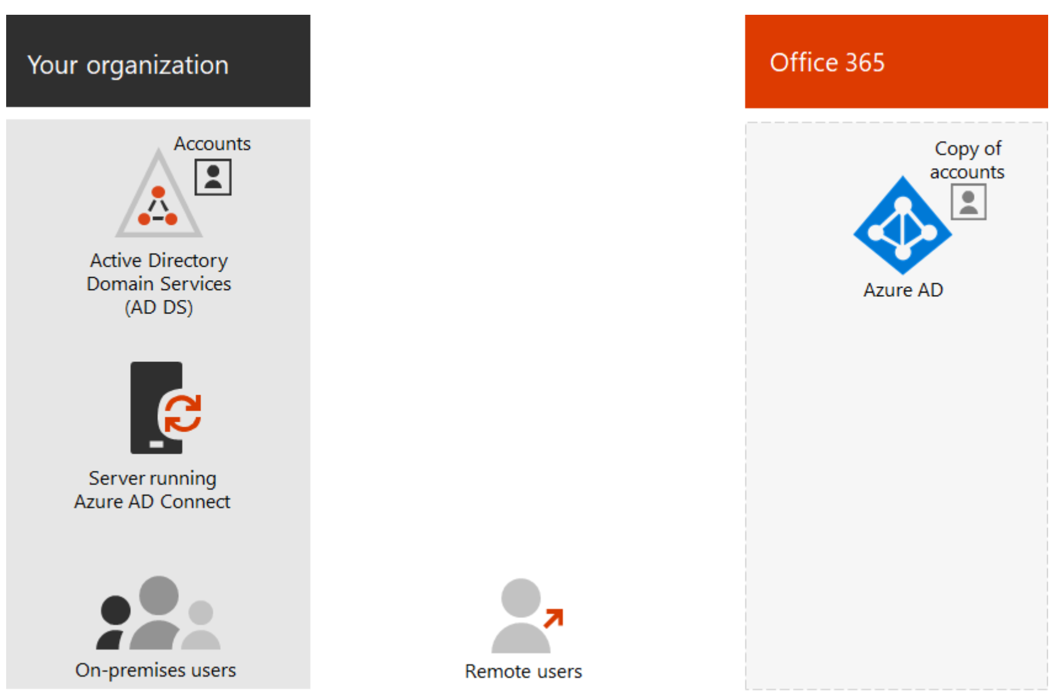
Hybrid Identity - AD Connect (most common)
Hybrid identity uses accounts that originate in an on-premises AD DS and have a copy in the Azure AD tenant of a Microsoft 365 subscription.
Notes:
Hybrid identity uses accounts that originate in an on-premises AD DS and have a copy in the Azure AD tenant of a Microsoft 365 subscription.
Most changes only flow one way.
Changes that you make to AD DS user accounts are synchronized to their copy in Azure AD.
Changes made to cloud-based accounts in Azure AD, such as new user accounts, are not synchronized with AD DS.
Azure AD Connect provides the ongoing account synchronization. It runs on an on-premises server, checks for changes in the AD DS, and forwards those changes to Azure AD.
When you implement hybrid identity, your on-premises AD DS is the authoritative source for account information.
This means that you perform administration tasks mostly on-premises, which are then synchronized to Azure AD.
Both on-premises and remote (online) users use their Azure AD user accounts and passwords to access Microsoft 365 cloud services.
Azure AD authenticates user credentials based on its stored user accounts and passwords.

Slide 10
Site Creation
Notes:
Key idea of this section: Create your corresponding site in SharePoint Online prior to migration

Slide 11
Site Creation Overview
Migrated data lives inside document libraries in the SharePoint sites.
Sites can be created either before or during the migration.
There are several different sites that can be created, including:
OneDrive
Modern, Classic, Team SharePoint sites
Communication (Hub Site)
Methods learned here will be used in Module 4 to create sites during the scenarios.

Slide 12
Create OneDrive Sites
OneDrive for Business sites can be created in the following ways:
User initiated:
OneDrive for Business sites are not created for your users when they are assigned a license.
Sites are created the first time a user incites a task that would require OneDrive for Business.
Admin pre-provisioning:
Create OneDrive when you add a new employee.
Create OneDrive sites as part of a migration from SharePoint Server on-premises to Microsoft 365, or from another online storage service.

Slide 13
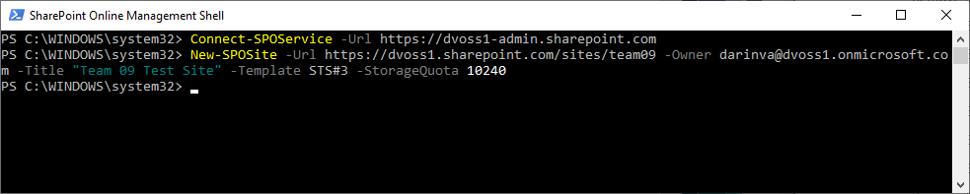
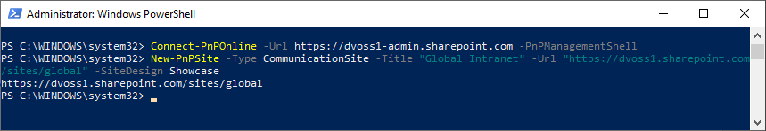
Create SharePoint Team Sites in PowerShell
PowerShell SharePoint Online Management Shell
PowerShell PnP Online Management Shell
Notes:
SPO Management Shell Download: https://www.microsoft.com/en-us/download/details.aspx?id=35588
PowerShell PnP Online Management Shell: https://docs.microsoft.com/en-us/powershell/sharepoint/sharepoint-pnp/sharepoint-pnp-cmdlets

Slide 14
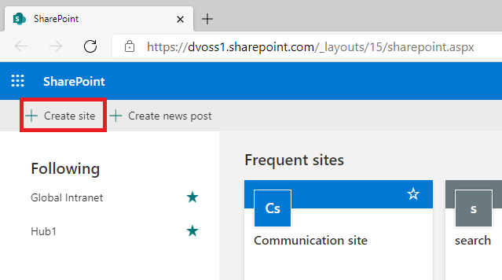
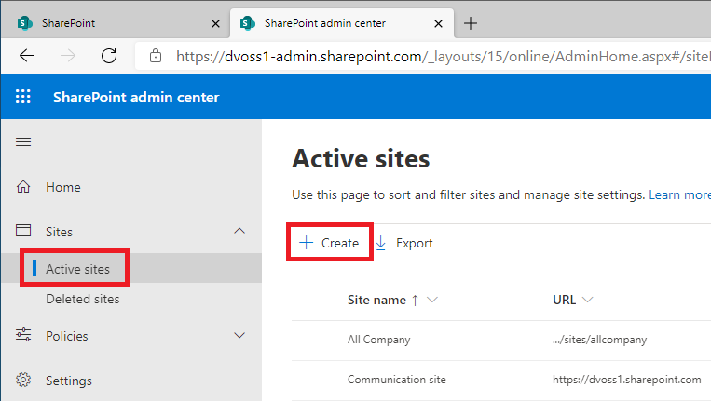
Create SharePoint Team Sites in the UI
SharePoint App →
SharePoint Admin Center →

Slide 15
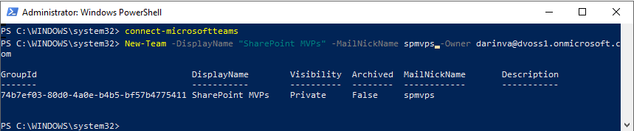
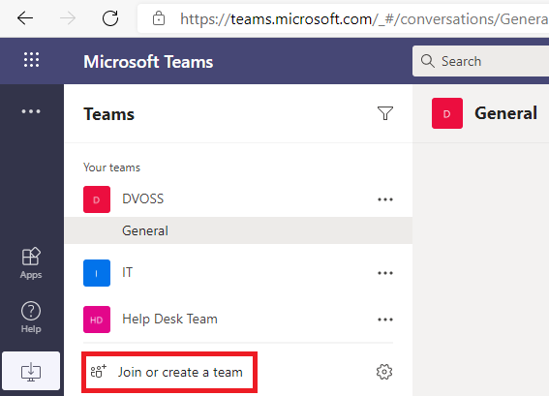
Create Microsoft Teams
Microsoft Teams PowerShell
Teams App →
(Requires permissions to create a M365 Group)

Slide 16
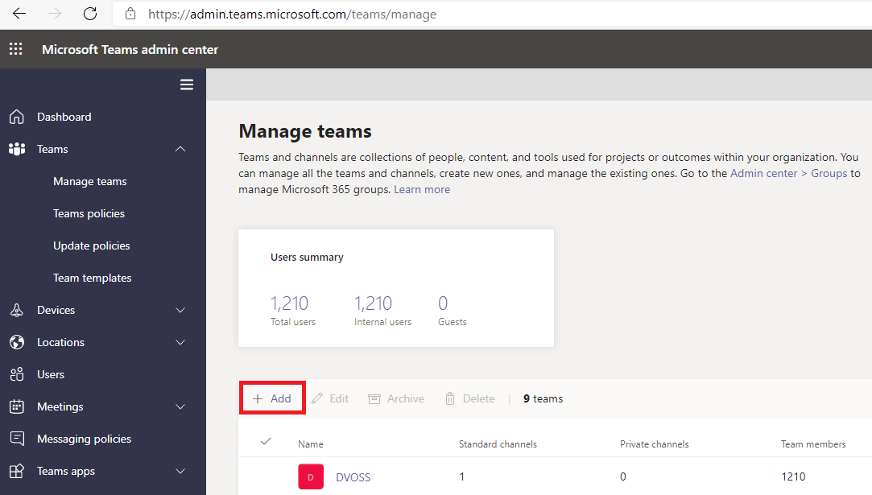
Create Microsoft Teams Continued…
Microsoft Teams admin center →

Slide 17
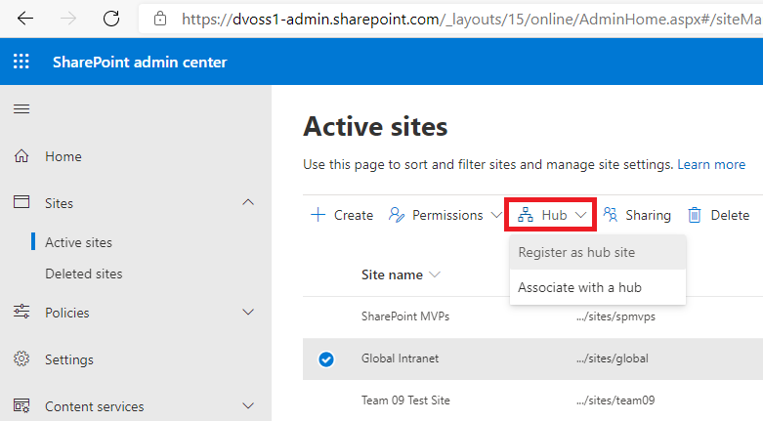
Create a Hub Sites
Connect sites together using the Hubs.
Connect Hubs to other Hubs.
Register and manage Hub Sites using the SharePoint Admin Center
Alternatively, use PowerShell:
https://docs.microsoft.com/en-us/sharepoint/dev/features/hub-site/create-hub-site-with-powershell

Slide 18
Tenant Settings

Slide 19
Tenant Settings and Tools Overview
Before any migration it is important to be aware of the default configuration settings on the target tenant.
Review all configuration settings.
Create a governance plan for the organization.
Align the configuration settings to support the governance plan:
Sharing settings
External user access
Content classification, auditing, labeling, retention, etc.
Group/Team/Site creation experience
Site templates
App store

Slide 20
Migration Related Tenant Settings to Consider
Security
External Sharing
Sensitivity Labels
Access Policies
Custom Scripts
Governance
Self-Service Site Creation
Site and Content Retention
Settings on Root site
SharePoint Store
OneDrive Deletion (MySite Cleanup)
SPO Storage Quota
Everyone has 'contribute' access by default
Specify whether users can get apps from the SharePoint Store
By default, users can get or request apps from the SharePoint Store
View or manage app requests
Specify whether to allow apps for Office to start in documents

Slide 21
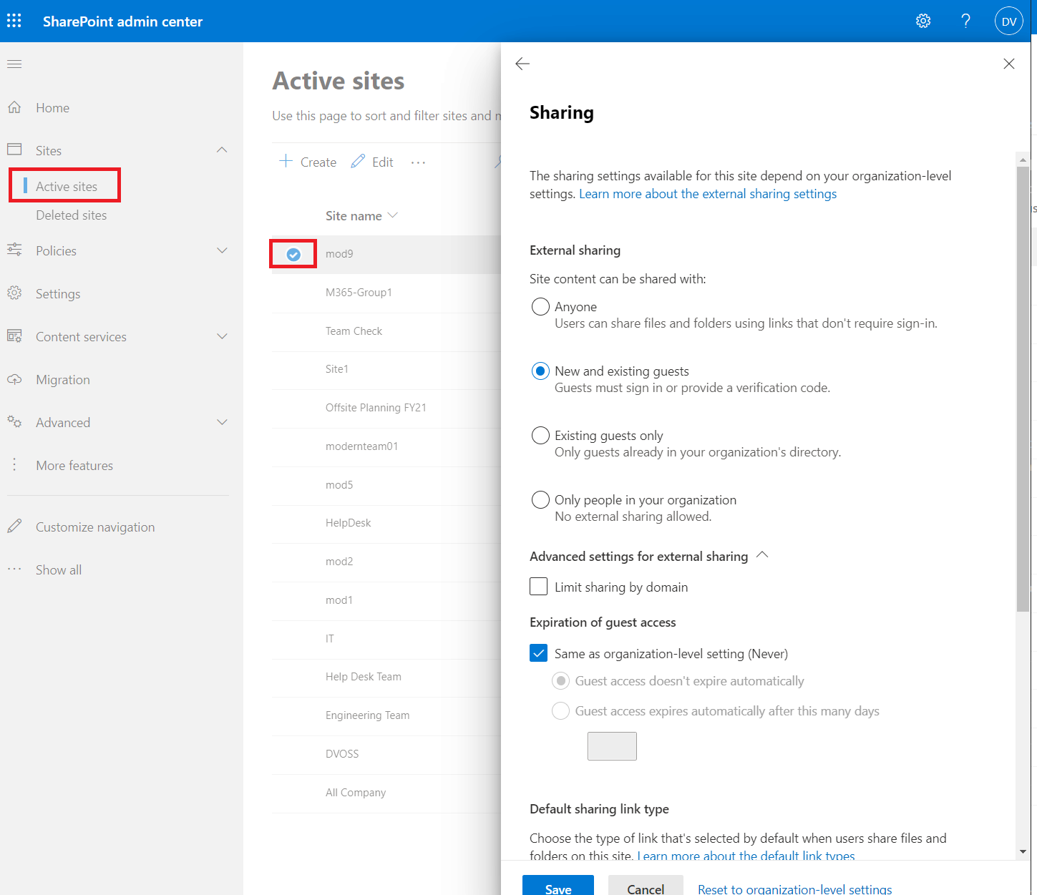
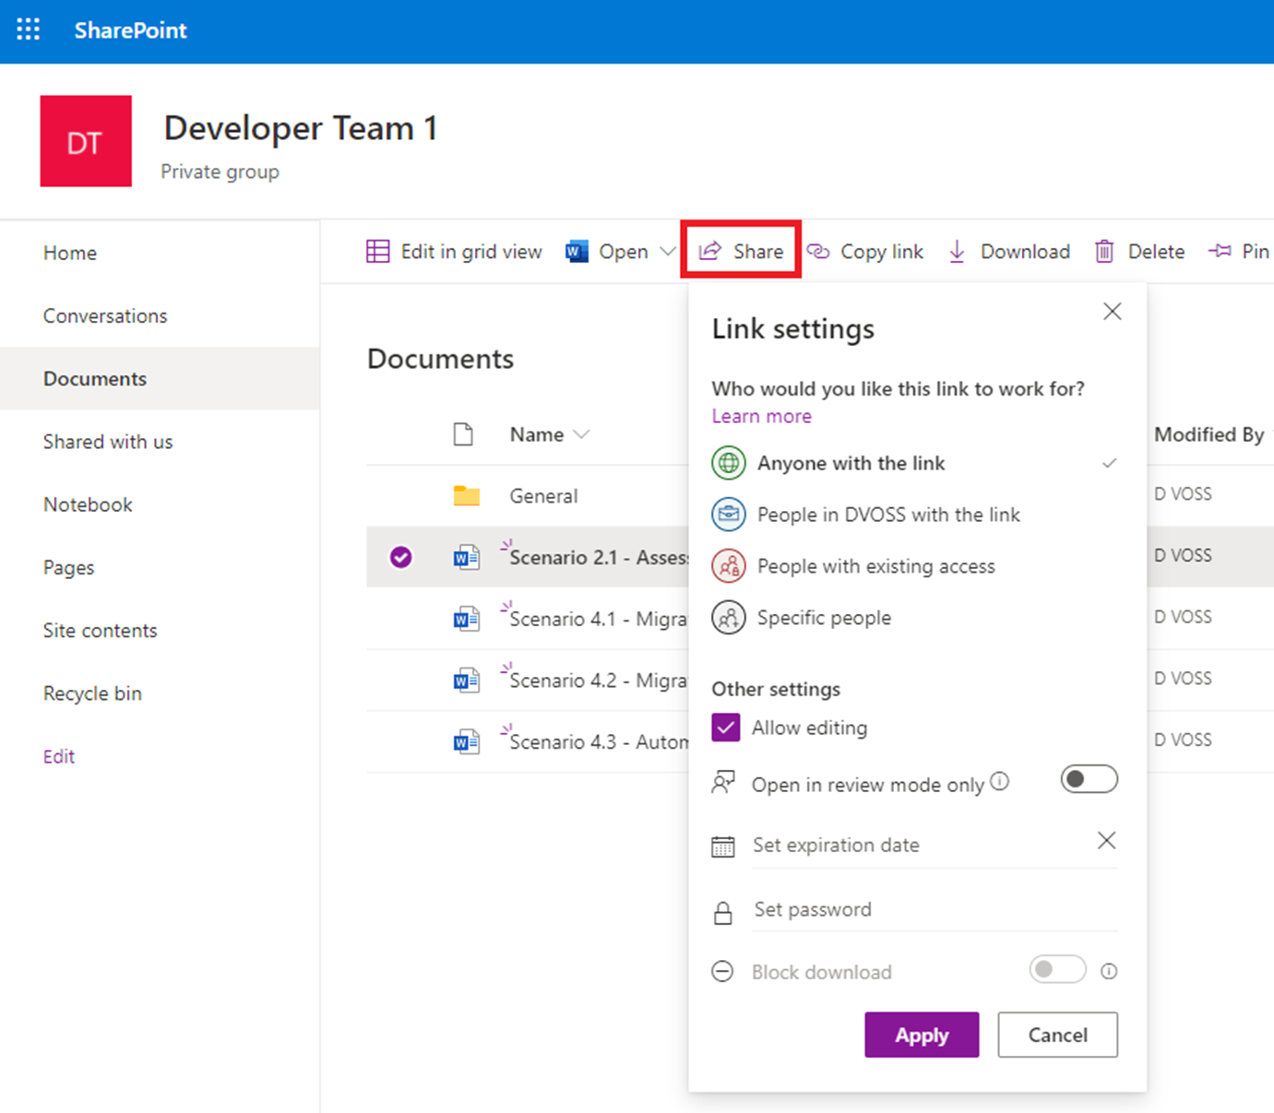
External Permission Best Practices
Notes:
Do not handle external sharing during the act of migration.
Assess existing external sharing content.
Determine if it is worthy to remain externally shared.
Determine if the content is suited for OneDrive or SharePoint.
Reshare files externally after the migration.

Slide 22
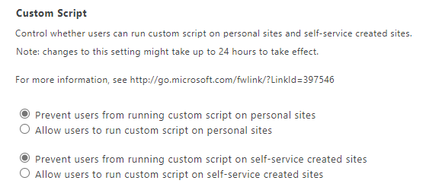
SharePoint Online Custom Scripts
Custom scripts are only supported on classic sites.
Admins can control whether users can run custom scripts.
This setting is turned off by default as a security best practice.
Access the Custom Script settings in the Classic SharePoint admin center:

Slide 23
Roles and Permissions
Administrators have access to sensitive data. Follow these guidelines to keep the organization's data more secure:
Have 2-4 Global Admins
Assign the least permissive role
Require multi-factor authentication for admins
Have at least 2 global admins in your organization in case of account lockout
Global admin has almost unlimited access to your org's settings and most of the data.
Assigning the least permissive role means giving admins only the access they need to get the job done.
For example:
Global Admin vs. SharePoint Admin

Slide 24
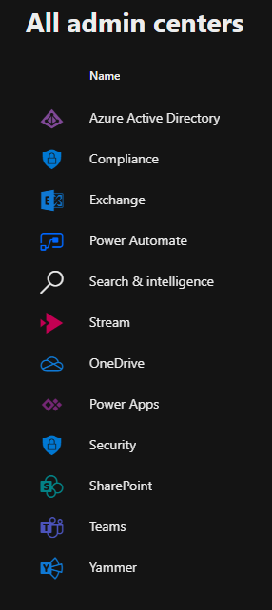
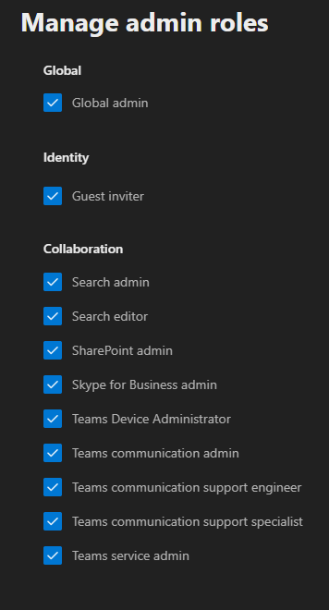
Role Considerations
Microsoft 365 comes with a set of admin roles.
Each admin role maps to common business functions.
Admin roles allow users to do specific tasks in the admin centers →
The following roles should be considered for migration to SharePoint Online →
https://docs.microsoft.com/en-us/office365/admin/add-users/about-admin-roles?view=o365-worldwide
Notes:
Microsoft 365 Admin Center
https://portal.office.com/adminportal/
SharePoint Admin Center
https://admin.microsoft.com/sharepoint
OneDrive Admin Center
https://admin.onedrive.com/
Teams Admin Center
https://admin.teams.microsoft.com/

Slide 25
Migration Account Access
Migration account requires permissions to read/create/modify in SharePoint Online:
If the migration tool is going to create sites, then SharePoint Admin role is required.
Site collection Admin of the target site at a minimum.
Migration account must also have Full Read access to the source sites or file shares.
Third-party tools may require different access. Check with the ISV or partner.
Notes:
Understand the access needed for data review and migration.

Slide 26
Hybrid

Slide 27
Hybrid Overview
Hybrid integrates SharePoint Online with on-premises SharePoint Server to provide unified functionality and access to data.
Hybrid enables trusted communications between SharePoint Online and SharePoint Server.
There is a Hybrid Wizard that automates the hybrid configuration.
There are several hybrid capabilities available (covered on the next slide)

Slide 28
Hybrid Capabilities
Search (Federated Search or Cloud Hybrid Search)
Sites
OneDrive
Profiles (use Delve profile in SPO)
Extensible App Launcher
Business Connectivity Services (BCS)
Taxonomy (Managed Metadata)
Notes:
https://docs.microsoft.com/sharepoint/hybrid/configure-office-365-for-sharepoint-hybrid

Slide 29
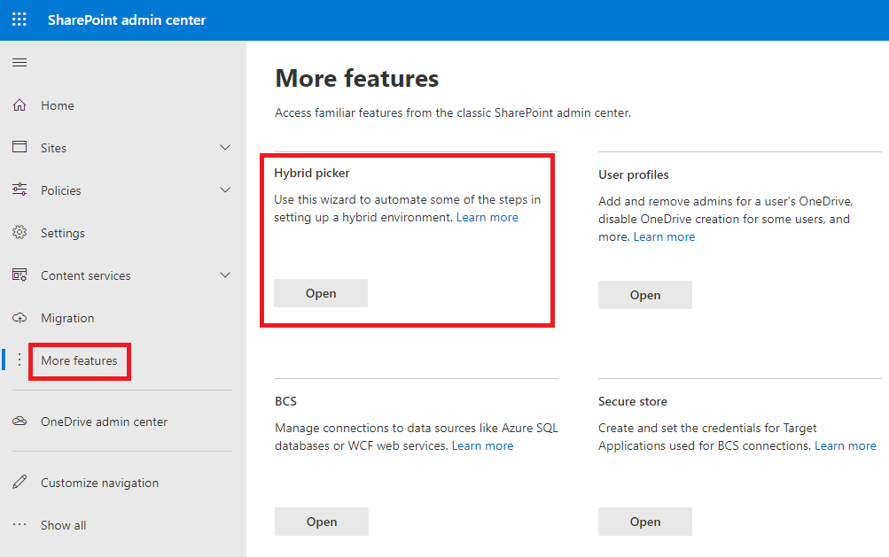
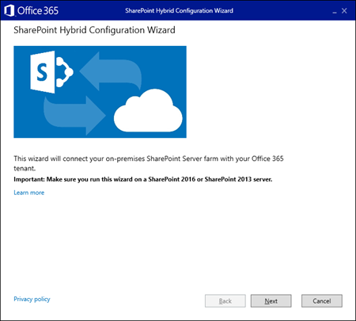
Hybrid Configuration Wizard
Notes:
Hybrid picker in the SharePoint Online admin center - https://docs.microsoft.com/en-us/SharePoint/hybrid/hybrid-picker-in-the-sharepoint-online-admin-center
Find a link to download the wizard from the SharePoint admin center.
Run the wizard from an Application Server in the SharePoint Server farm.
The wizard automates certain configuration steps and enables hybrid features mentioned on the previous slide.
The wizard creates a Server-to-Server (S2S)/OAuth connection.

Slide 30

End of Presentation – Microsoft Logo

